Slide 1


Patter Coders

Slide 2
Table of contents
01
About us
03
Our idea
02
Stages of creation
A brief overview of who we are.
Description of our concept.
Detailing the progression of our creation process.

Slide 3
01
About us
Our essence.

Slide 4
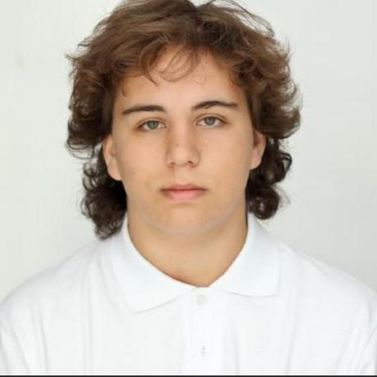
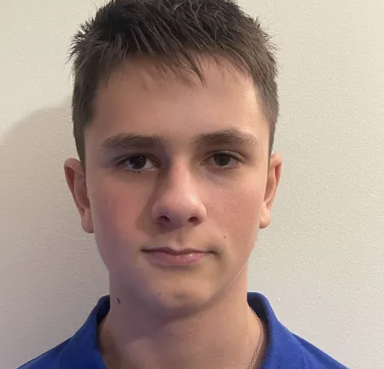
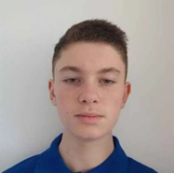
Our team members

Slide 5
Stages of creation
02

Slide 6
Our stages
Create the design
Testing the application
Come up with the idea
Implement the design
Create the presentation and documentation

Slide 7
03
Our idea

Slide 8
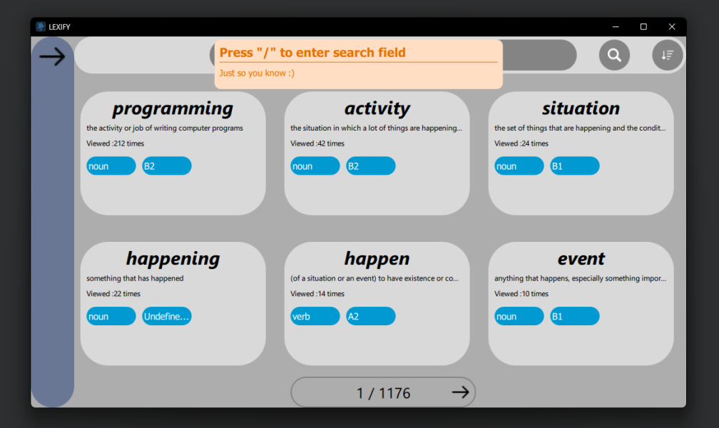
Our concept
Our English Vocabulary application offers 7,000 words ranging from A1 to C1 levels, each with a clear explanation. Designed to help learners at all stages, it provides a comprehensive tool for building and enhancing your vocabulary.

Slide 9
Lets jump to the app!

